Slide 1
Capstone Project by
Coding with Performance on Big Data
Statistics & Modeling
Vivek Pandiyan
Communicating Results for Decision-Making
Venn Diagram of Data Science Skills

Slide 2
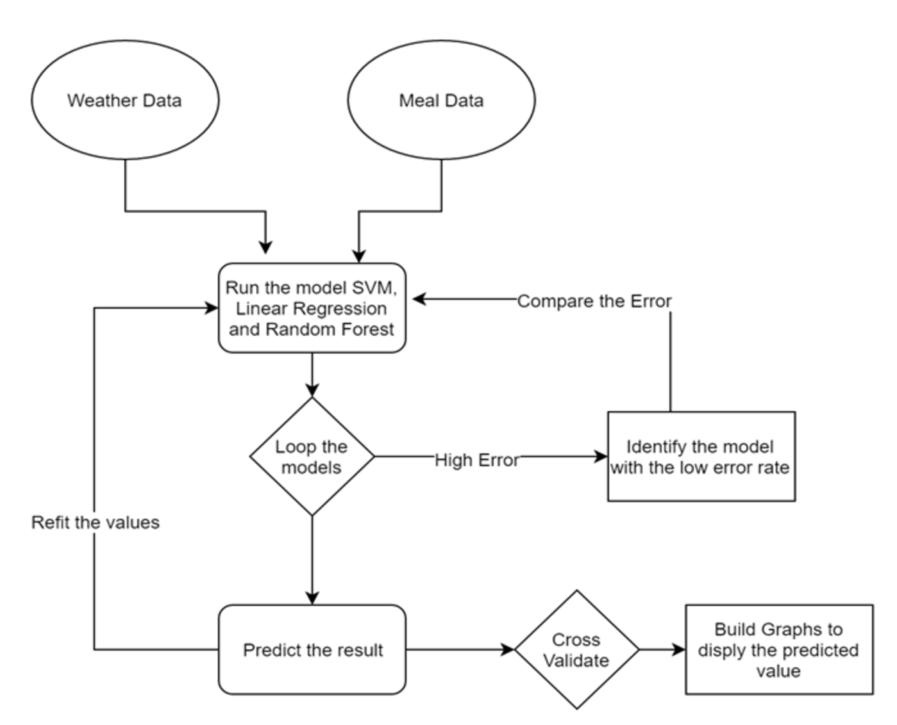
Flow Chart

Slide 3
Flow Chart Description
Scrap the data from web to get the temperature, Pressure, Wind Speed, Humidity etc.
Join the data with the sales records to understand the variable importance.
Run the model across all the data for each day in the system.
Compute the results and co relate with the other results from other models and find the best suited model.

Slide 4
Project Methodology
Used modern ETL tools to increase the performance
Interactive live dashboards for simplying data interpretation.
Used simpler methodology to produce the same result as my competitor.
Designed/Structured the methodology to work with the like data and used TERR to data manipulate using Spotfire.

Slide 5
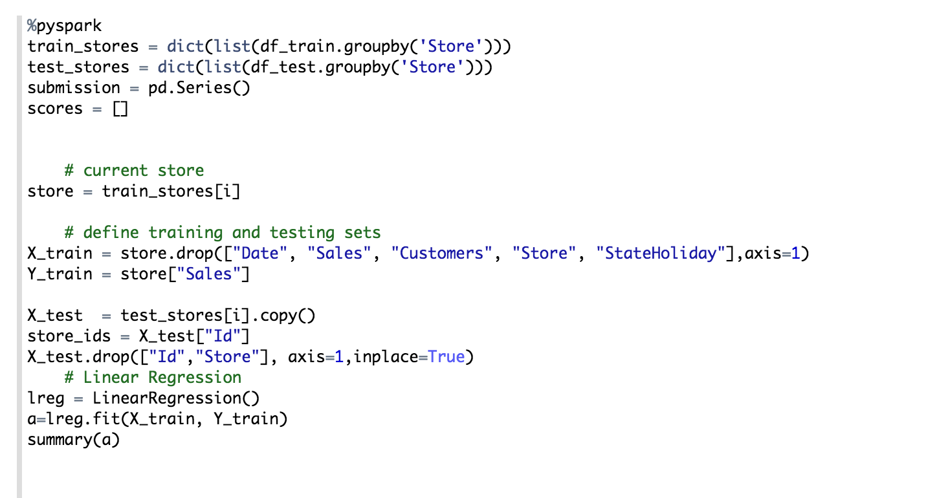
Method

Slide 6
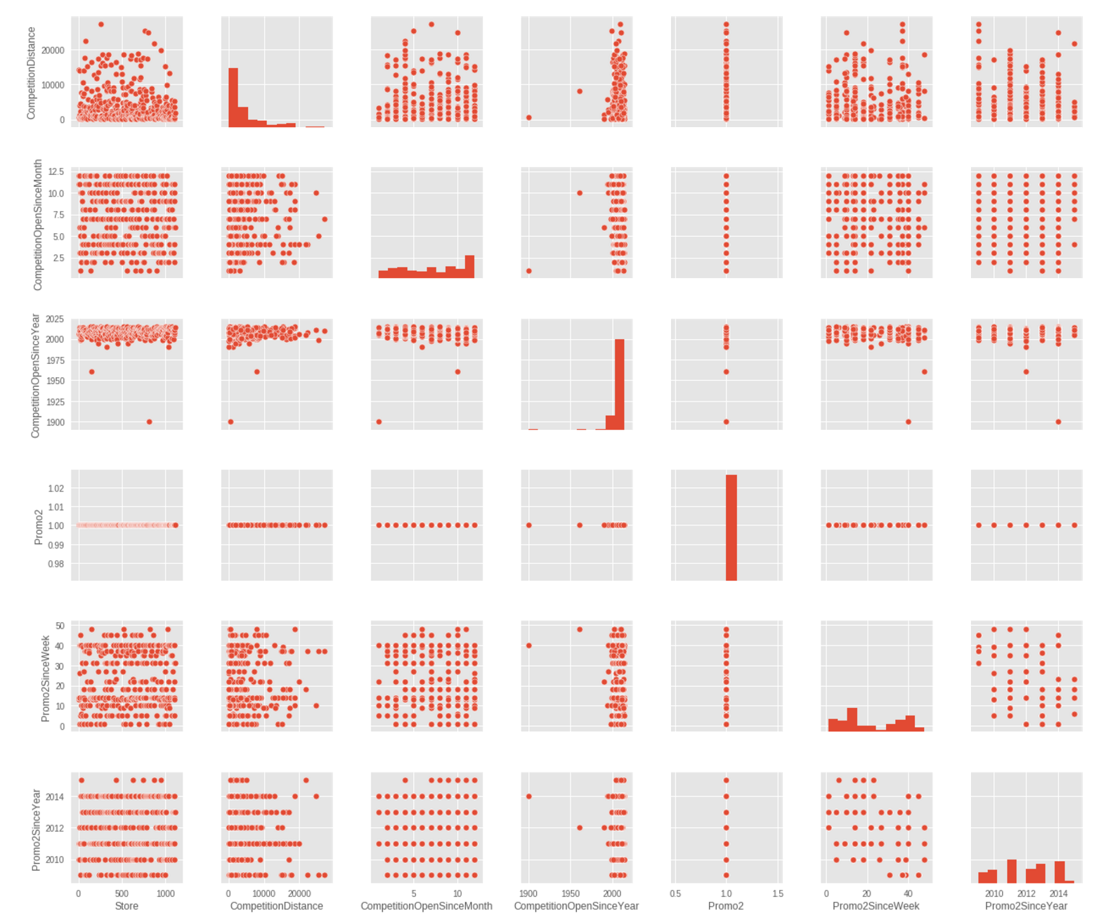
Variable Selection

Slide 7
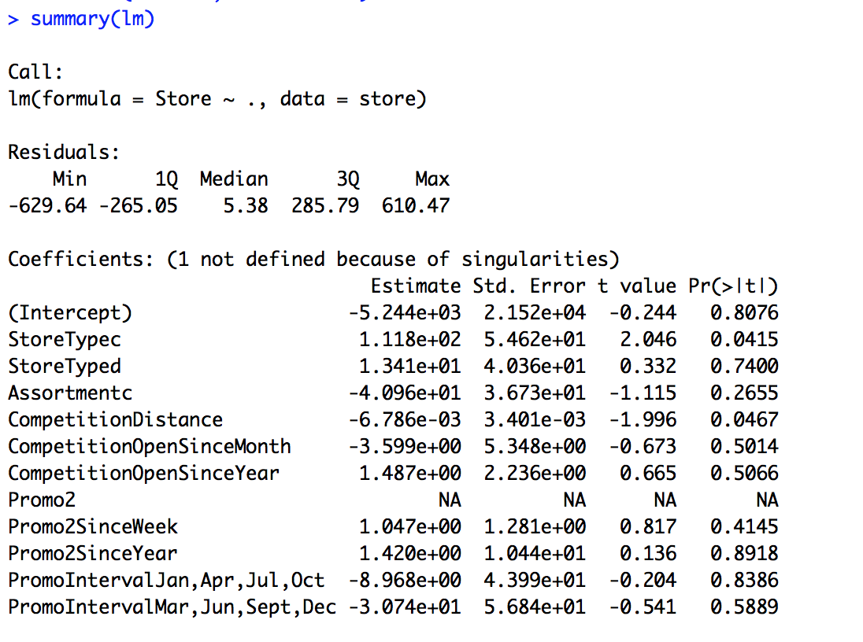
P value

Slide 8
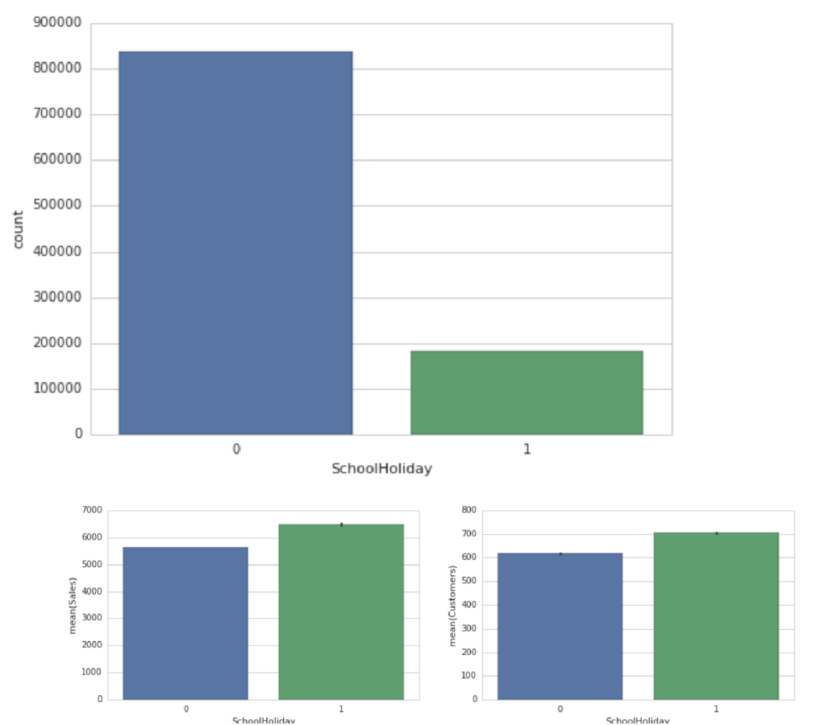
Bar chart to indicate Sales to Holidays

Slide 9
Methods Used
Linear Regression –
For calculation the correlation between sales and customers
Random Forest
To identify the distribution of the sales for different temperature.
Arima Method
Forecast the future sales for a given location/store.

Slide 10
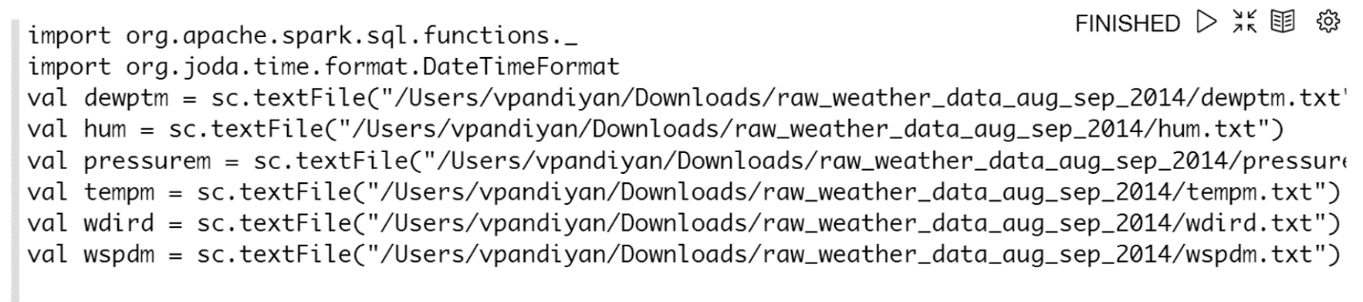
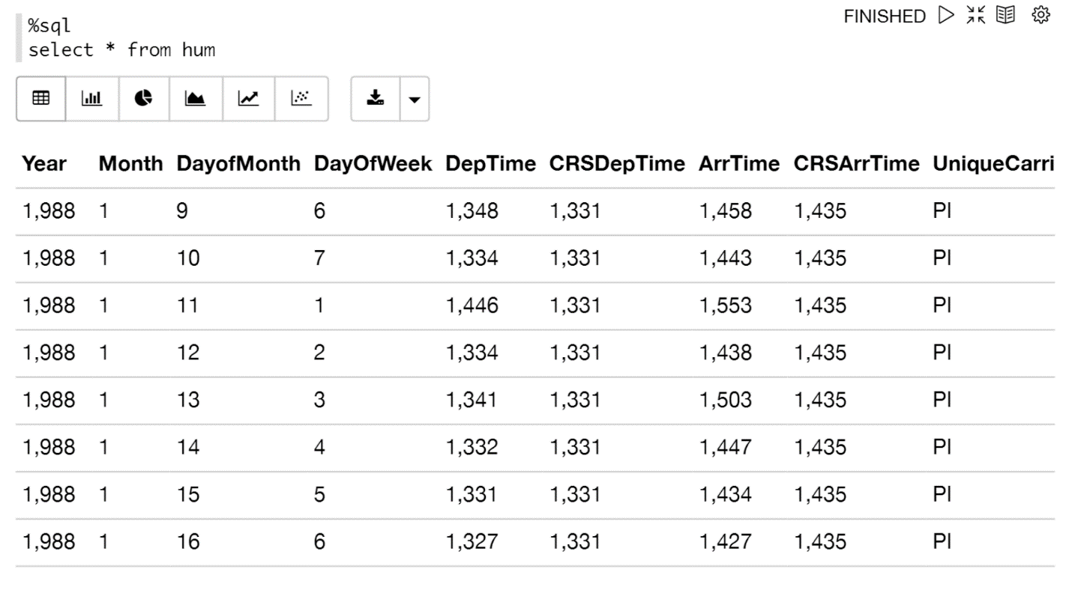
Code

Slide 11
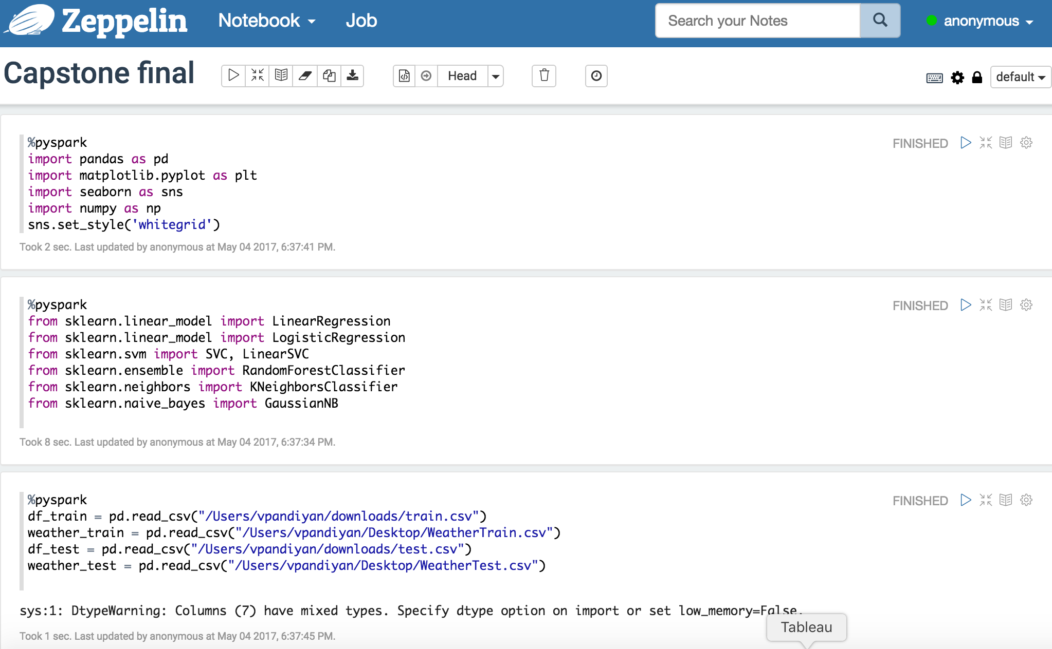
Packages and data load

Slide 12
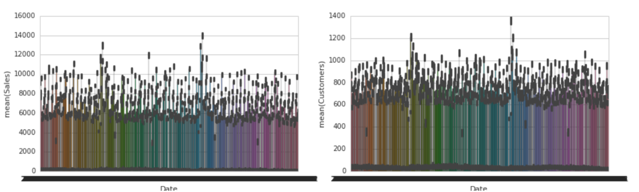
Mean Customer and Mean Sales for a given day based on the Weather

Slide 13
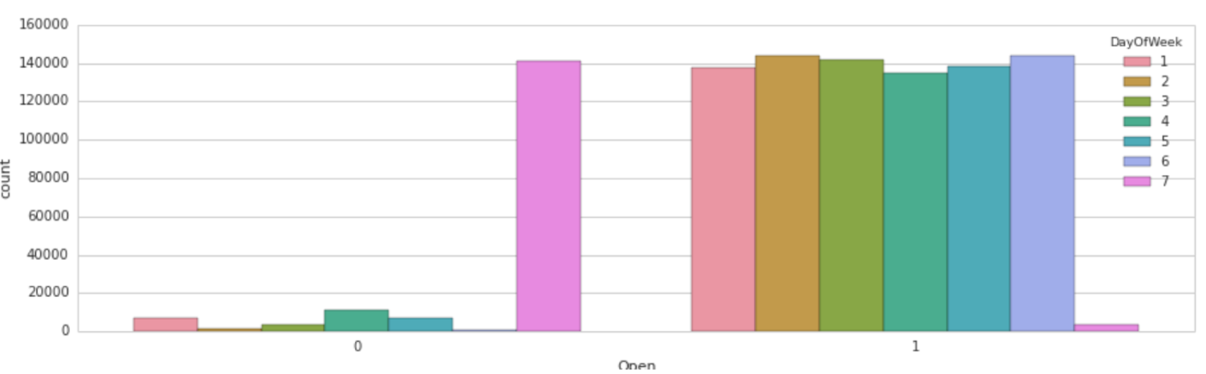
Count on Weekdays vs Weekends

Slide 14
Regression

Slide 15
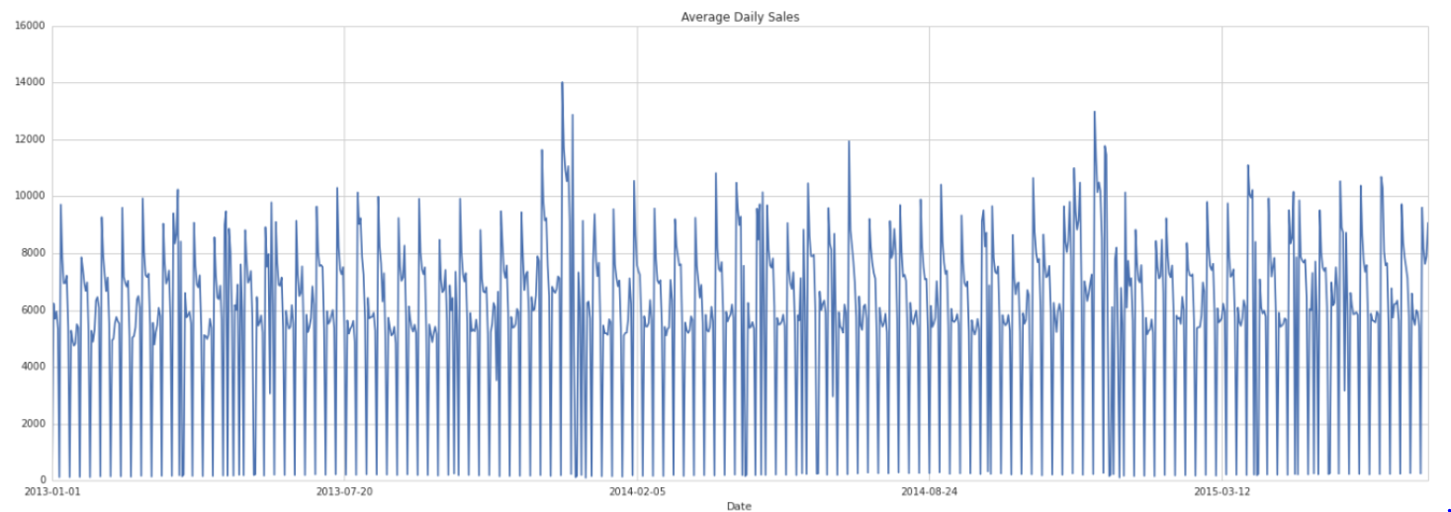
Daily Average sales on the stores based on Temperature

Slide 16
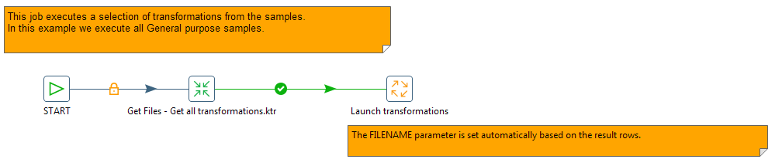
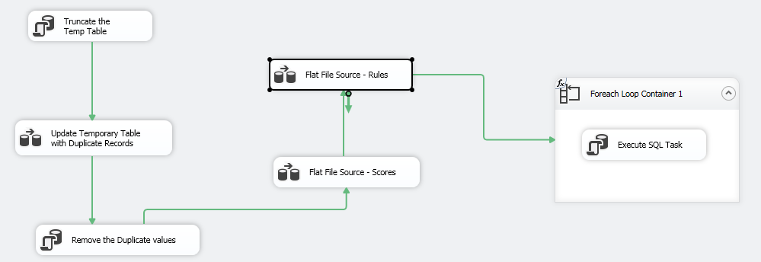
ETL Method
Pentaho Package
SSIS package

Slide 17

Outcome
Co-relation matrix to calculate the accuracy
Mean accuracy of thee model

Slide 18
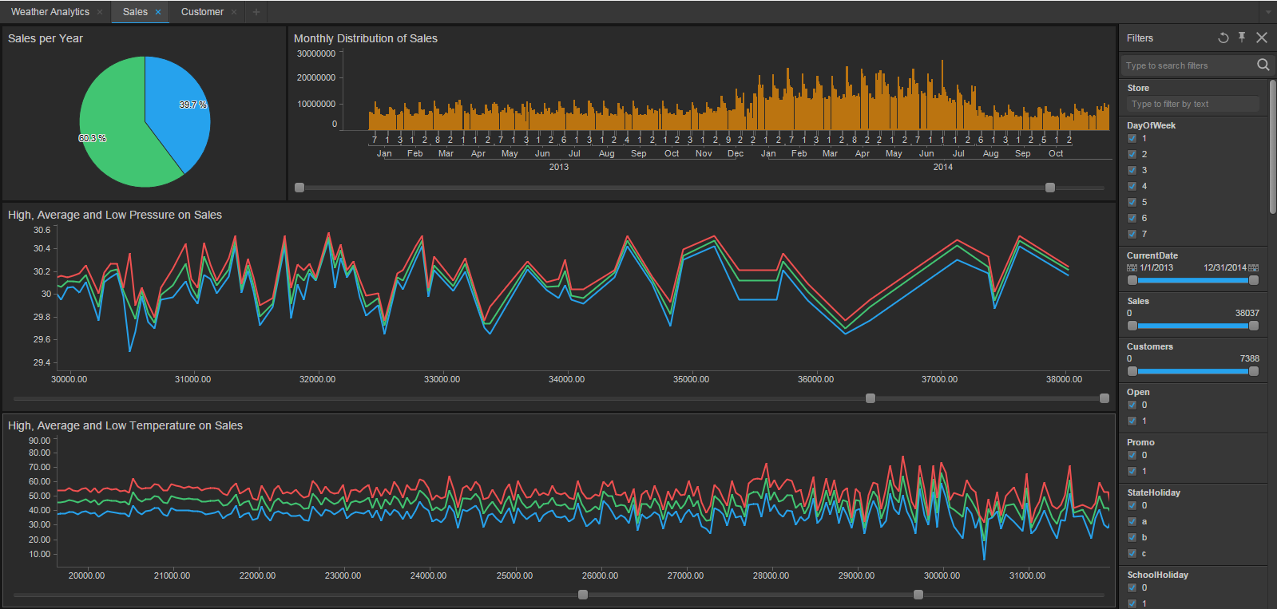
Spotfire Result 1

Slide 19
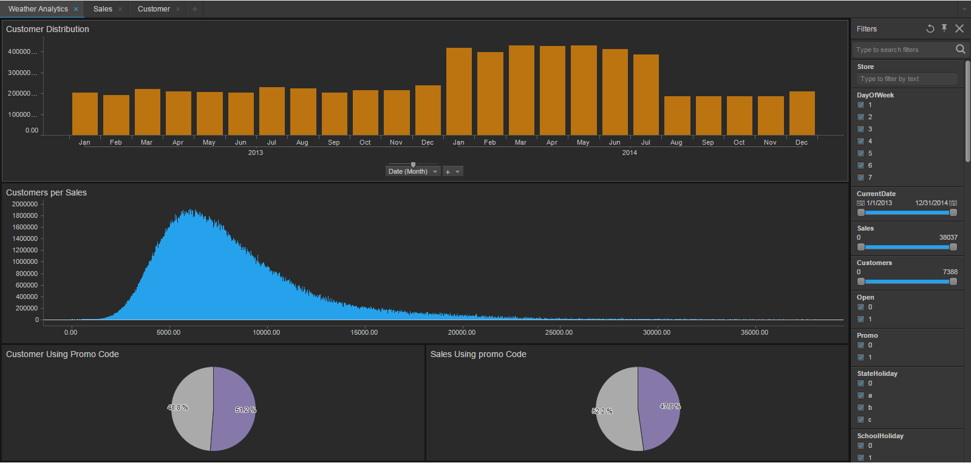
Spotfire Result 2

Slide 20
Refrences
Spencer, Matthew, et al. "Executing multiple pipelined data analysis operations in the grid." Proceedings of the 2002 ACM/IEEE conference on Supercomputing. IEEE Computer Society Press, 2002.
Kim, Hwi-Gang, Seongjoo Lee, and Sunghyon Kyeong. "Discovering hot topics using Twitter streaming data social topic detection and geographic clustering." Advances in Social Networks Analysis and Mining (ASONAM), 2013 IEEE/ACM International Conference on. IEEE, 2013.
Buneci, Emma S., and Daniel A. Reed. "Analysis of application heartbeats: Learning structural and temporal features in time series data for identification of performance problems." Proceedings of the 2008 ACM/IEEE conference on Supercomputing. IEEE Press, 2008.
Wolski, Rich, Neil Spring, and Chris Peterson. "Implementing a performance forecasting system for metacomputing the network weather service." Supercomputing, ACM/IEEE 1997 Conference. IEEE, 1997.
Roe, Kevin, Duane Stevens, and Carol McCord. "High resolution weather modeling for improved fire management." Proceedings of the 2001 ACM/IEEE Conference on Supercomputing. ACM, 2001.
James Stephen, Julian, et al. "Program analysis for secure big data processing." Proceedings of the 29th ACM/IEEE international conference on Automated software engineering. ACM, 2014.
Swany, Martin, and Rich Wolski. "Multivariate resource performance forecasting in the network weather service." Supercomputing, ACM/IEEE 2002 Conference. IEEE, 2002.
Primet, Pascale, Robert Harakaly, and Franck Bonnassieux. "Experiments of network throughput measurement and forecasting using the network weather." Cluster Computing and the Grid, 2002. 2nd IEEE/ACM International Symposium on. IEEE, 2002.
Cheng, Shanjun, Anita Raja, and Victor Lesser. "Multiagent meta-level control for a network of weather radars." Web Intelligence and Intelligent Agent Technology (WI-IAT), 2010 IEEE/WIC/ACM International Conference on. Vol. 2. IEEE, 2010.
Roe, Kevin, Duane Stevens, and Carol McCord. "High resolution weather modeling for improved fire management." Proceedings of the 2001 ACM/IEEE Conference on Supercomputing. ACM, 2001.

